Slide 1
wedding photo booth rentals los angeles
https://sites.google.com/view/photoboothrentalmissionviejo/home
Notes:
https://drive.google.com/file/d/1pHgskUK_krYyDwJ2RjRzXe2G9rbWULVq/view?usp=sharing
https://drive.google.com/file/d/10pk6RpJ_i-YsGqBep1agWFziEdNEQlpu/view?usp=sharing
https://drive.google.com/file/d/1WBAEst0YJxt16LHoXg1ym9n2ls1jzRTQ/view?usp=sharing
https://docs.google.com/document/d/14_zZBZCesDgo7I9jpxOzitjkSSbYrm5K51wwC_ayrHg/edit?usp=sharing
https://docs.google.com/document/d/14_zZBZCesDgo7I9jpxOzitjkSSbYrm5K51wwC_ayrHg/pub
https://docs.google.com/document/d/14_zZBZCesDgo7I9jpxOzitjkSSbYrm5K51wwC_ayrHg/view
https://docs.google.com/presentation/d/1WPXVtqkHLGWROUyHQUR0Z2iAXOs5jf7t58VKhYpbI08/edit?usp=sharing
https://docs.google.com/presentation/d/1WPXVtqkHLGWROUyHQUR0Z2iAXOs5jf7t58VKhYpbI08/pub?start=true&loop=true&delayms=3000
https://docs.google.com/presentation/d/1WPXVtqkHLGWROUyHQUR0Z2iAXOs5jf7t58VKhYpbI08/view
https://docs.google.com/presentation/d/1WPXVtqkHLGWROUyHQUR0Z2iAXOs5jf7t58VKhYpbI08/htmlpresent

Slide 4
wedding photo booth rentals los angeles
We provide the photo booths, the props, the backdrops, and more. We are even willing to travel to los Angeles and around Orange County as needed. All you have to do is contact us today and rent your photo booth near Laguna Hills. At our family run company, we provide an exceptional photo and video service coupled with beautiful videos that can leave a positive impression on your event attendees. We aim to provide the best customer service for a Laguna Hills Photo Booth For rent. We are a one-stop shop for all of your Laguna Hills Photo Booth rentals and party entertainment needs. We provide everything you need for your Photo Booth rental, so it’s incredibly easy for you and your guests to enjoy the pictures you will create throughout your events. Our booths include many advanced features, like filters, addons, animated GIFs, boomerang videos, and HD videos. Get in touch with us a call today for your personalized quote. We can’t wait to help make your Laguna Hills, CA event stand out from all the rest! Here at Lucky Frog, we believe in the power of creating the very best 360 Videos. No matter if you’re inquiring about a corporate photo booth rental activation in Orange County or a wedding photo booth rental in Laguna Hills, the goal is to create photos that people can enjoy and share with their followers on social media. Photos and 360 videos are content that people can share and tag others in, which is why having a Laguna Hills photo booth rental at your Orange County event is the best way to help your event really come to life. No Orange County event is the same, which is why we take the time and effort to tailor every video booth rental to your corporate, birthday, or wedding theme.&nbsp;Our Orange County photo booth business has what it takes to remake your ​corporate photo booth rental in Laguna Hills completely. Contact us for all pricing inquiries, scheduling availability, or any other 360 photo booth rental requirements.
https://sites.google.com/view/photoboothrentalmissionviejo/home
Notes:
wedding photo booth rentals los angeles,photo booths rental prices los angeles,photo booths rental in los angeles

Slide 5
Contact Information
Lucky Frog Photo Booth | 360 Video Booth Rental Los Angeles
532 S Olive St, Los Angeles, CA 90013
562-303-9926
Notes:
Lucky Frog Photo Booth | 360 Video Booth Rental Los Angeles532 S Olive St, Los Angeles, CA 90013562-303-9926

Slide 6
More info about us:
wedding photo booth rentals los angeles
photo booths rental prices los angeles
photo booths rental in los angeles
Notes:
Lucky Frog Photo Booth | 360 Video Booth Rental Los Angeles532 S Olive St, Los Angeles, CA 90013562-303-9926

Slide 7
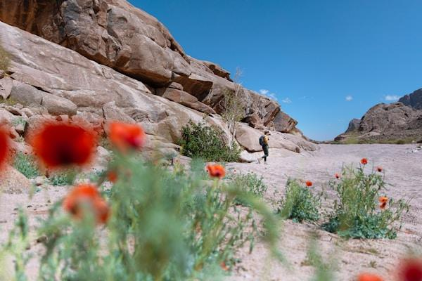

Slide 8
Links
List of recommended resources
Notes:
wedding photo booth rentals los angeles,photo booths rental prices los angeles,photo booths rental in los angeles

Slide 9
Please visit :
photo
photo
photo
document
document pub
document view
presentation
presentation pub
presentation view
presentation html
Notes:
https://drive.google.com/file/d/1pHgskUK_krYyDwJ2RjRzXe2G9rbWULVq/view?usp=sharing
https://drive.google.com/file/d/10pk6RpJ_i-YsGqBep1agWFziEdNEQlpu/view?usp=sharing
https://drive.google.com/file/d/1WBAEst0YJxt16LHoXg1ym9n2ls1jzRTQ/view?usp=sharing
https://docs.google.com/document/d/14_zZBZCesDgo7I9jpxOzitjkSSbYrm5K51wwC_ayrHg/edit?usp=sharing
https://docs.google.com/document/d/14_zZBZCesDgo7I9jpxOzitjkSSbYrm5K51wwC_ayrHg/pub
https://docs.google.com/document/d/14_zZBZCesDgo7I9jpxOzitjkSSbYrm5K51wwC_ayrHg/view
https://docs.google.com/presentation/d/1WPXVtqkHLGWROUyHQUR0Z2iAXOs5jf7t58VKhYpbI08/edit?usp=sharing
https://docs.google.com/presentation/d/1WPXVtqkHLGWROUyHQUR0Z2iAXOs5jf7t58VKhYpbI08/pub?start=true&loop=true&delayms=3000
https://docs.google.com/presentation/d/1WPXVtqkHLGWROUyHQUR0Z2iAXOs5jf7t58VKhYpbI08/view
https://docs.google.com/presentation/d/1WPXVtqkHLGWROUyHQUR0Z2iAXOs5jf7t58VKhYpbI08/htmlpresent

Slide 10
wedding photo booth rentals los angeles
https://sites.google.com/view/photoboothrentalmissionviejo/home
Notes:
wedding photo booth rentals los angeles,photo booths rental prices los angeles,photo booths rental in los angeles

